Slide 1
COOKIE
THE
DOGGIE
Your New Bestie

Slide 2
ABOUT COOKIE
Topic: Improvement of Mental Health.
Aim: We aim to provide a user-friendly and pleasant AR-based application for people to improve their mental health free of cost.
Website: Click here.
Demo Video: Click here.

Slide 3

TECH STACK
Flutter as the development environment.
Dart as the programming language.
ARCore as the Software Development Kit.
Blender for 3D modelling and animation.
DialogFlow as the framework for Natural Language Processing.
Firebase as the database.
Android Studio for integration.
HTML CSS JS for Website.

Slide 4

PROBLEMS
According to the United Nations, depression is ranked third in the global burden of disease and is projected to rank first in 2030.
Inaccessibility of proper or frequent sessions and therapies.
Incapable to afford online therapies with psychologists

Slide 5

CURRENT SOLUTIONS
Healium, Wysa, BetterHelp, are examples of a few applications that are addressing the mental health problem.
But, they have limited features and some are not available in both Play Store and AppStore.
They also don’t provide an interface where all people can use the application.

Slide 6
WHAT SETS US APART?
An AR-based virtual best friend to encourage and motivate you
According to the Centers for Disease Control and Prevention, pets can manage depression
Our theme and choice of colours are based on colour psychology

Slide 7

GUIDING PRINCIPLES
MISSION
VISION
We aim to provide a user-friendly and pleasant platform to improve mental health of people.
We envision building a healthy community of peaceful and happy minds.

Slide 8
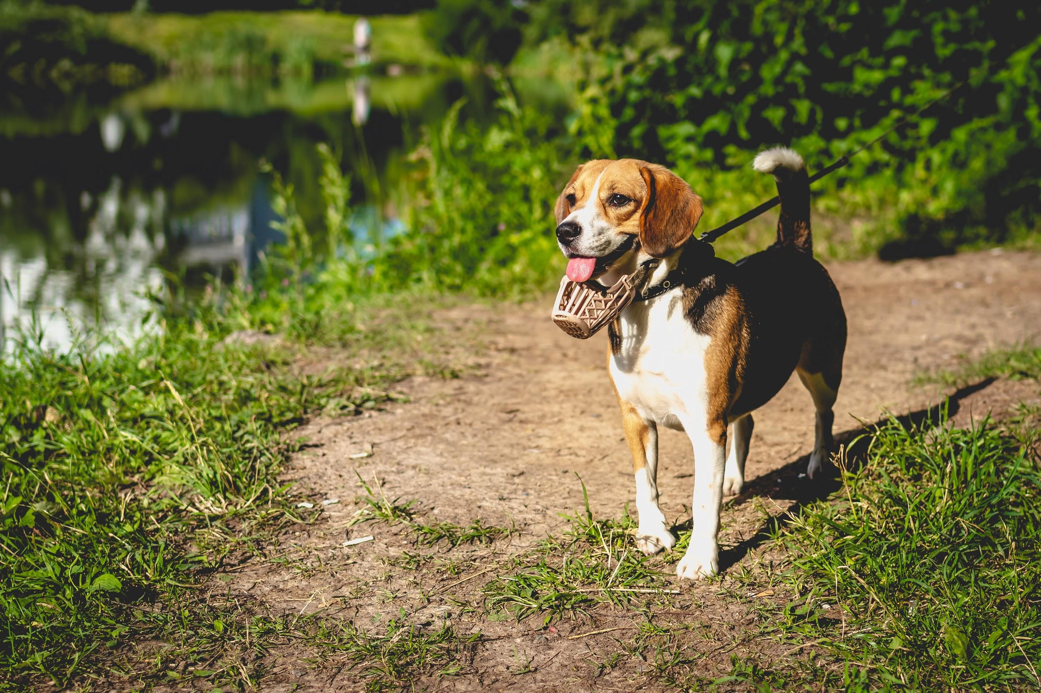
—JK Rowling
"
Happiness can be found even in the darkest of times,
If you remember to turn on the light.
-J K Rowling

Slide 9
MARKETING ANALYSIS

Slide 10
MARKETING STRATEGIES
20%
Effective Branding
60%
20%
Social media & networking sites
Merchandise

Slide 11
MARKET OPPORTUNITY
Our market includes the healthcare sector, hospitality industry, other producers and our services reach any people in need.
Our potential users include affected people, healthcare workers and merchants working for a social cause.

Slide 12
USER DEMOGRAPHICS
Depression scales, as of 2020
GENDER
14.9 %
22.0%
MAN
WOMAN
AGES
25-35
36-45
46-55

Slide 13



ANALYZING THE COMPETITION
HEALIUM
WYSA
BETTERHELP
AR App available only on App Store
App providing chat sessions.
App to get paid counselling online
But, they have limited features and some are not available in both play store and App Store. They also don’t provide an interface where all people can use the application.

Slide 14
GOALS & STRATEGY

Slide 15
OUR STORY
STEP 4
Cookie scales and personal goals. Person gets better.
STEP 5
STEP 1
Cookie dies and a new pet is assigned. Person continues to use the App.
A person with an upset mind
STEP 2
Woof! Cookie is introduced
STEP 3
Integration of variety of unique features

Slide 16
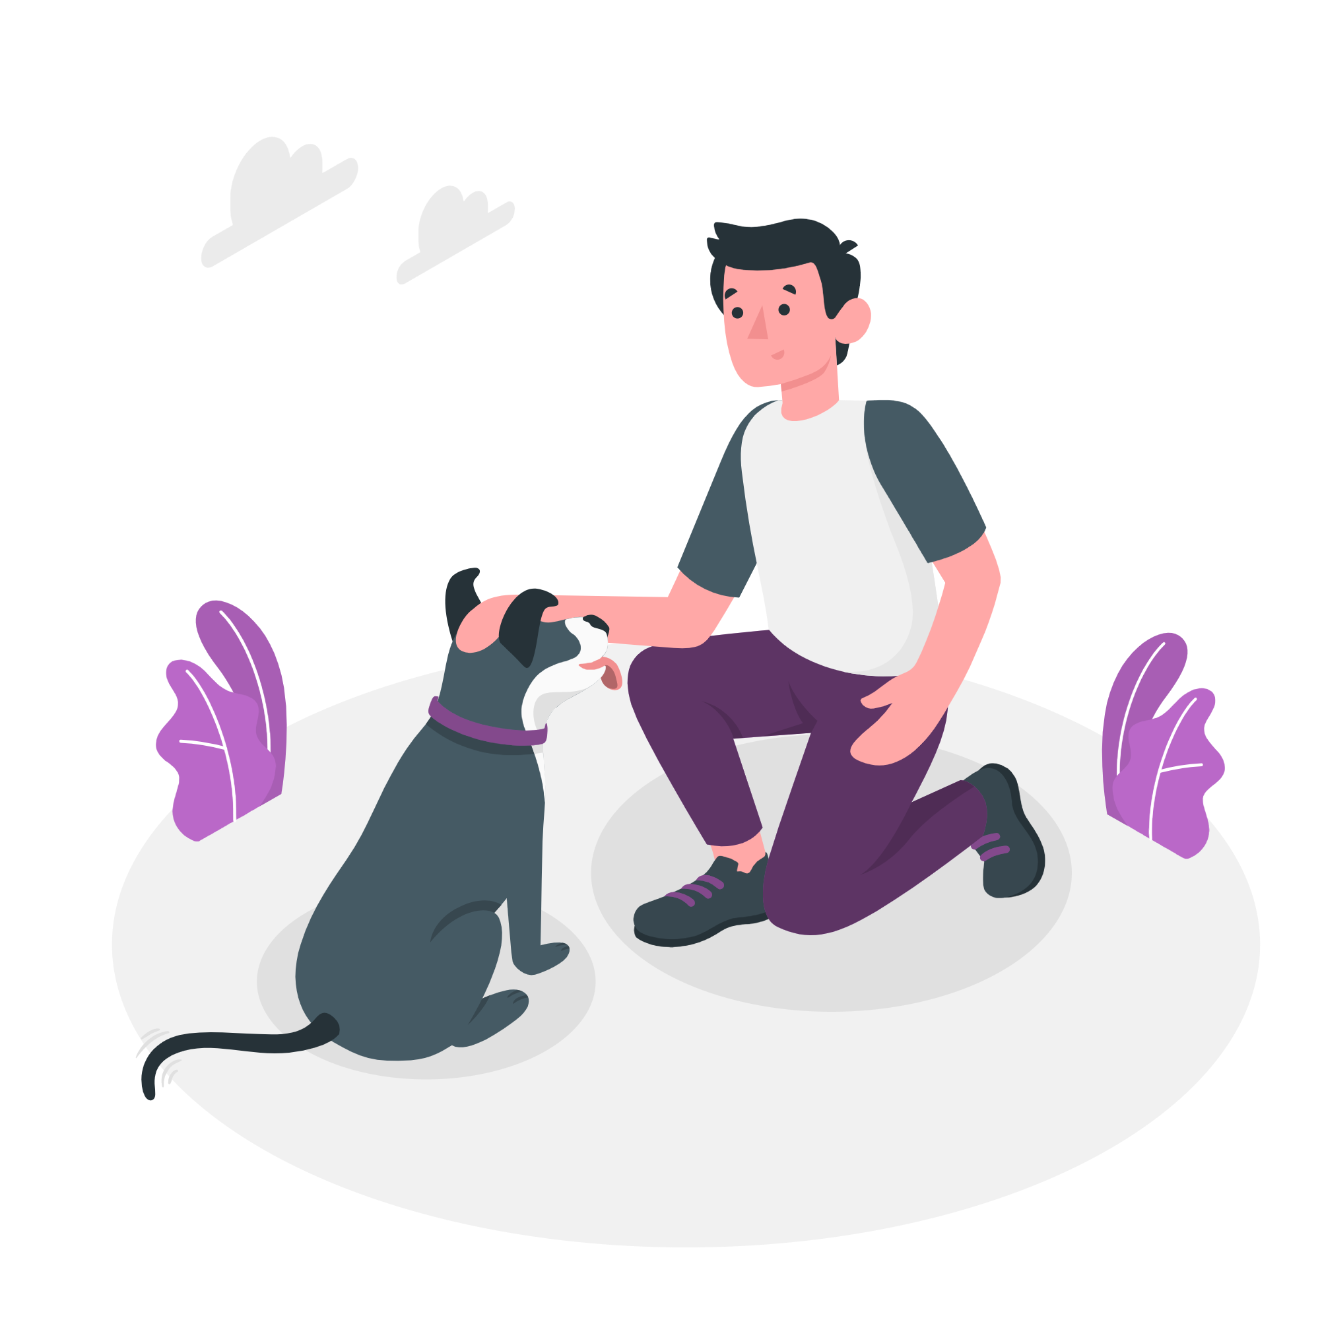
SPECIAL FEATURES
Daily reminders to encourage users to do their chores and works.
Users can also form groups with like-minded people.
Scientifically approved therapy sessions or exercises.
In case of urgent help, Cookie will provide an emergency helpline and other relevant contact information.
We are also developing different AR models for variety of breeds.
We will also personalize the voice of Cookie bot.

Slide 17
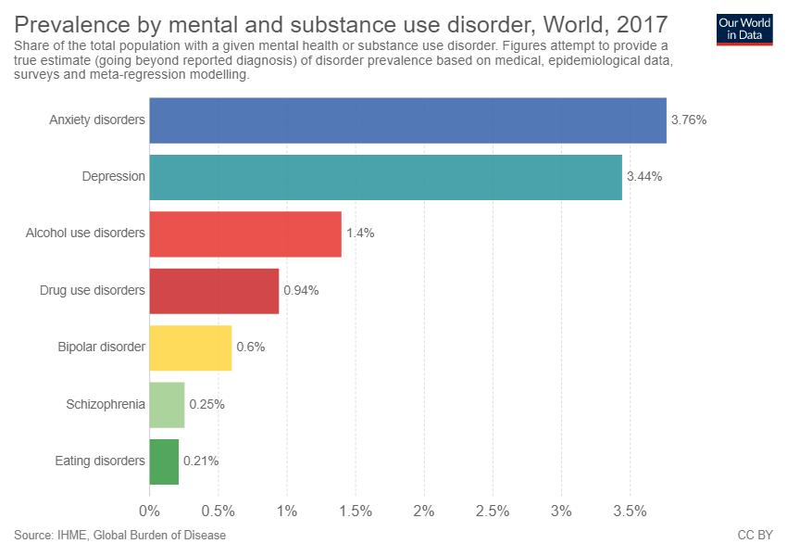

Slide 18
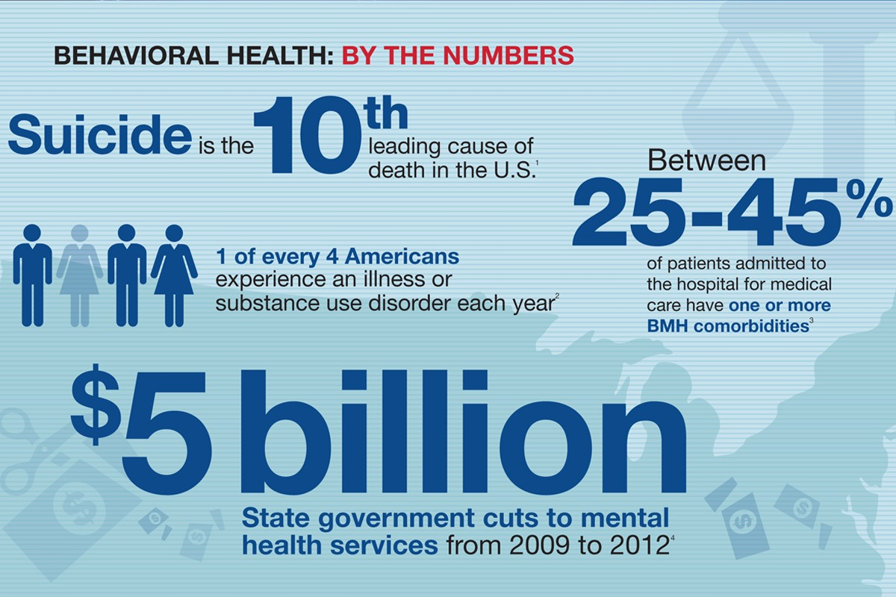
Source: Grainger

Slide 19
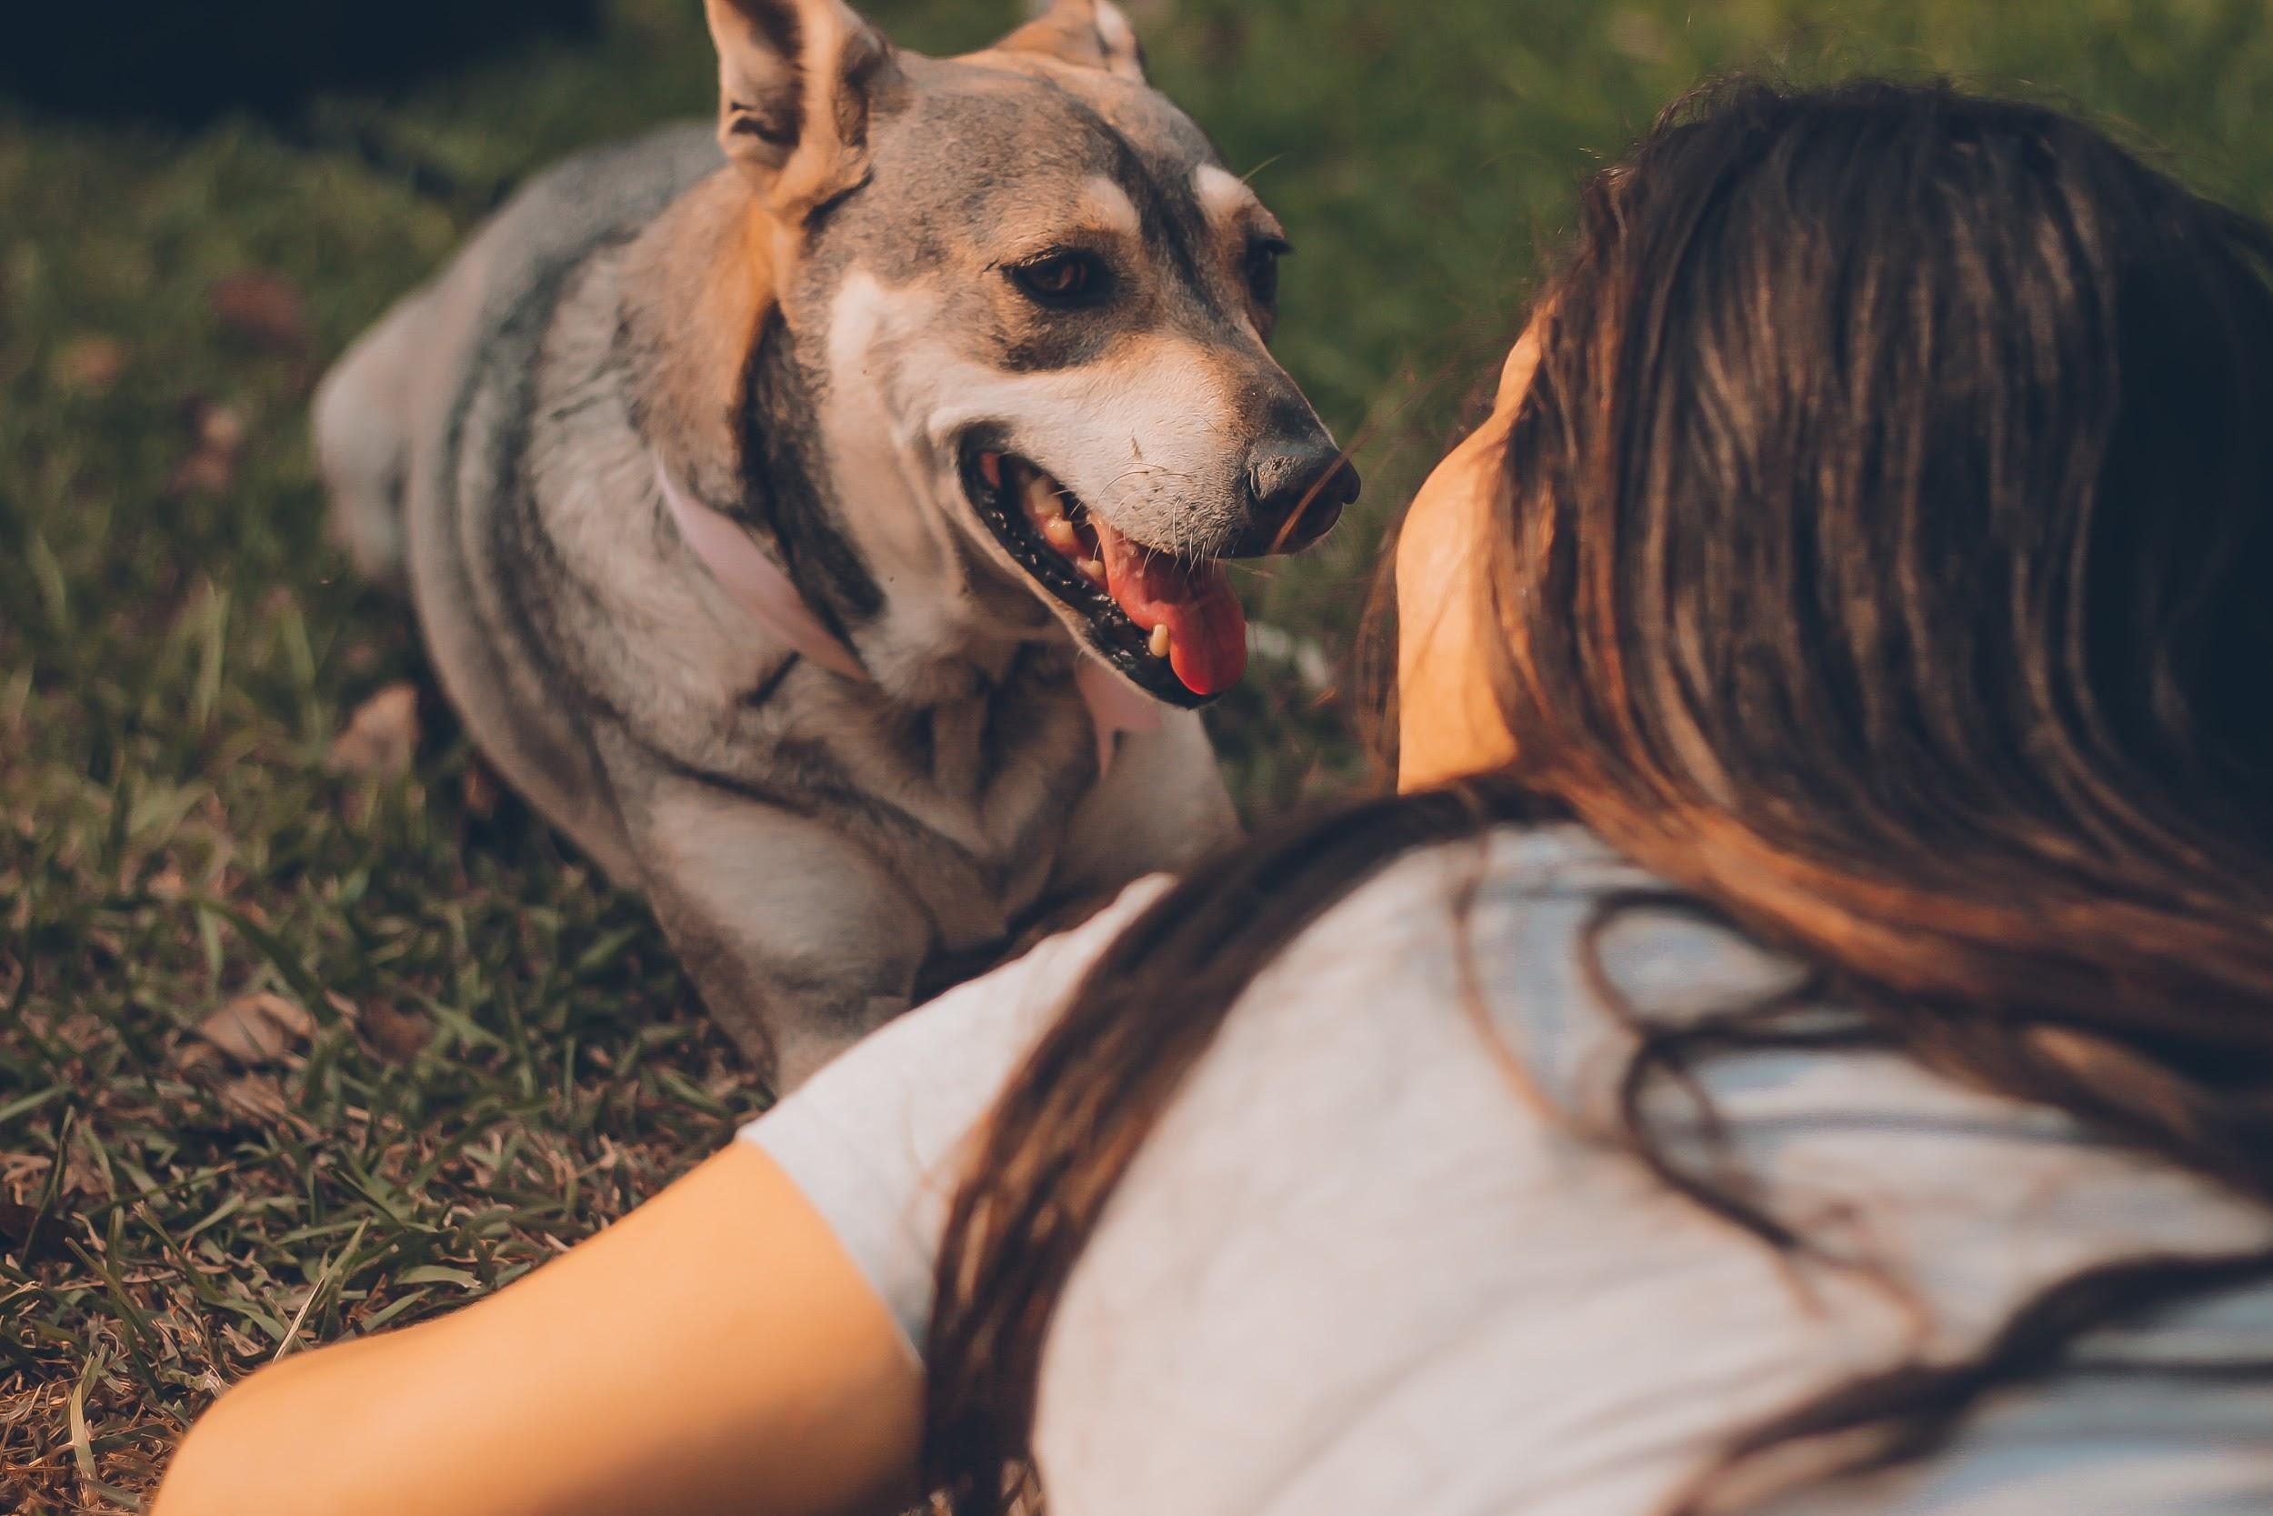
Some things just fill your heart without trying

Slide 20
WHAT MERCHANDISE
ARE WE GOING TO SELL?
COOKIE MERCH
STRESS REDUCING ITEMS
BOOKS

Slide 21

WHAT THEME
ARE WE GOING
TO USE?
Theme based on scientifically proven colours that help reduce stress, anxiety and bring in happiness!

Slide 22
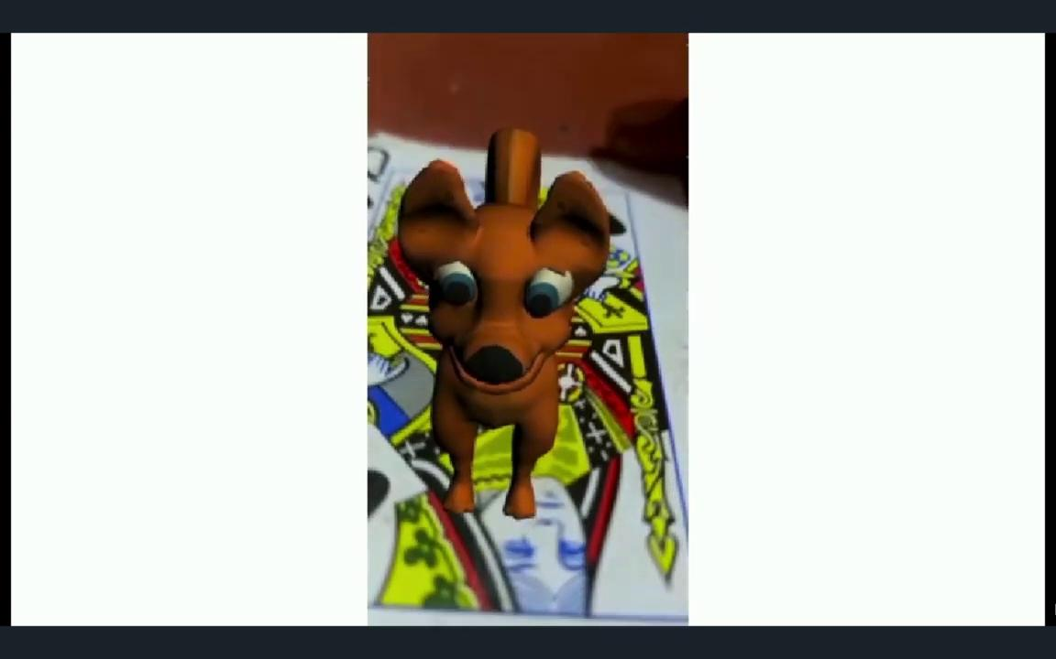
DEMO VIDEO

Slide 23
THE PLATFORMS WE’RE GOING TO USE
APPLICATION
WEBSITE
SOCIAL MEDIA
2020
2020
2020

Slide 24
BUDGET

Slide 25
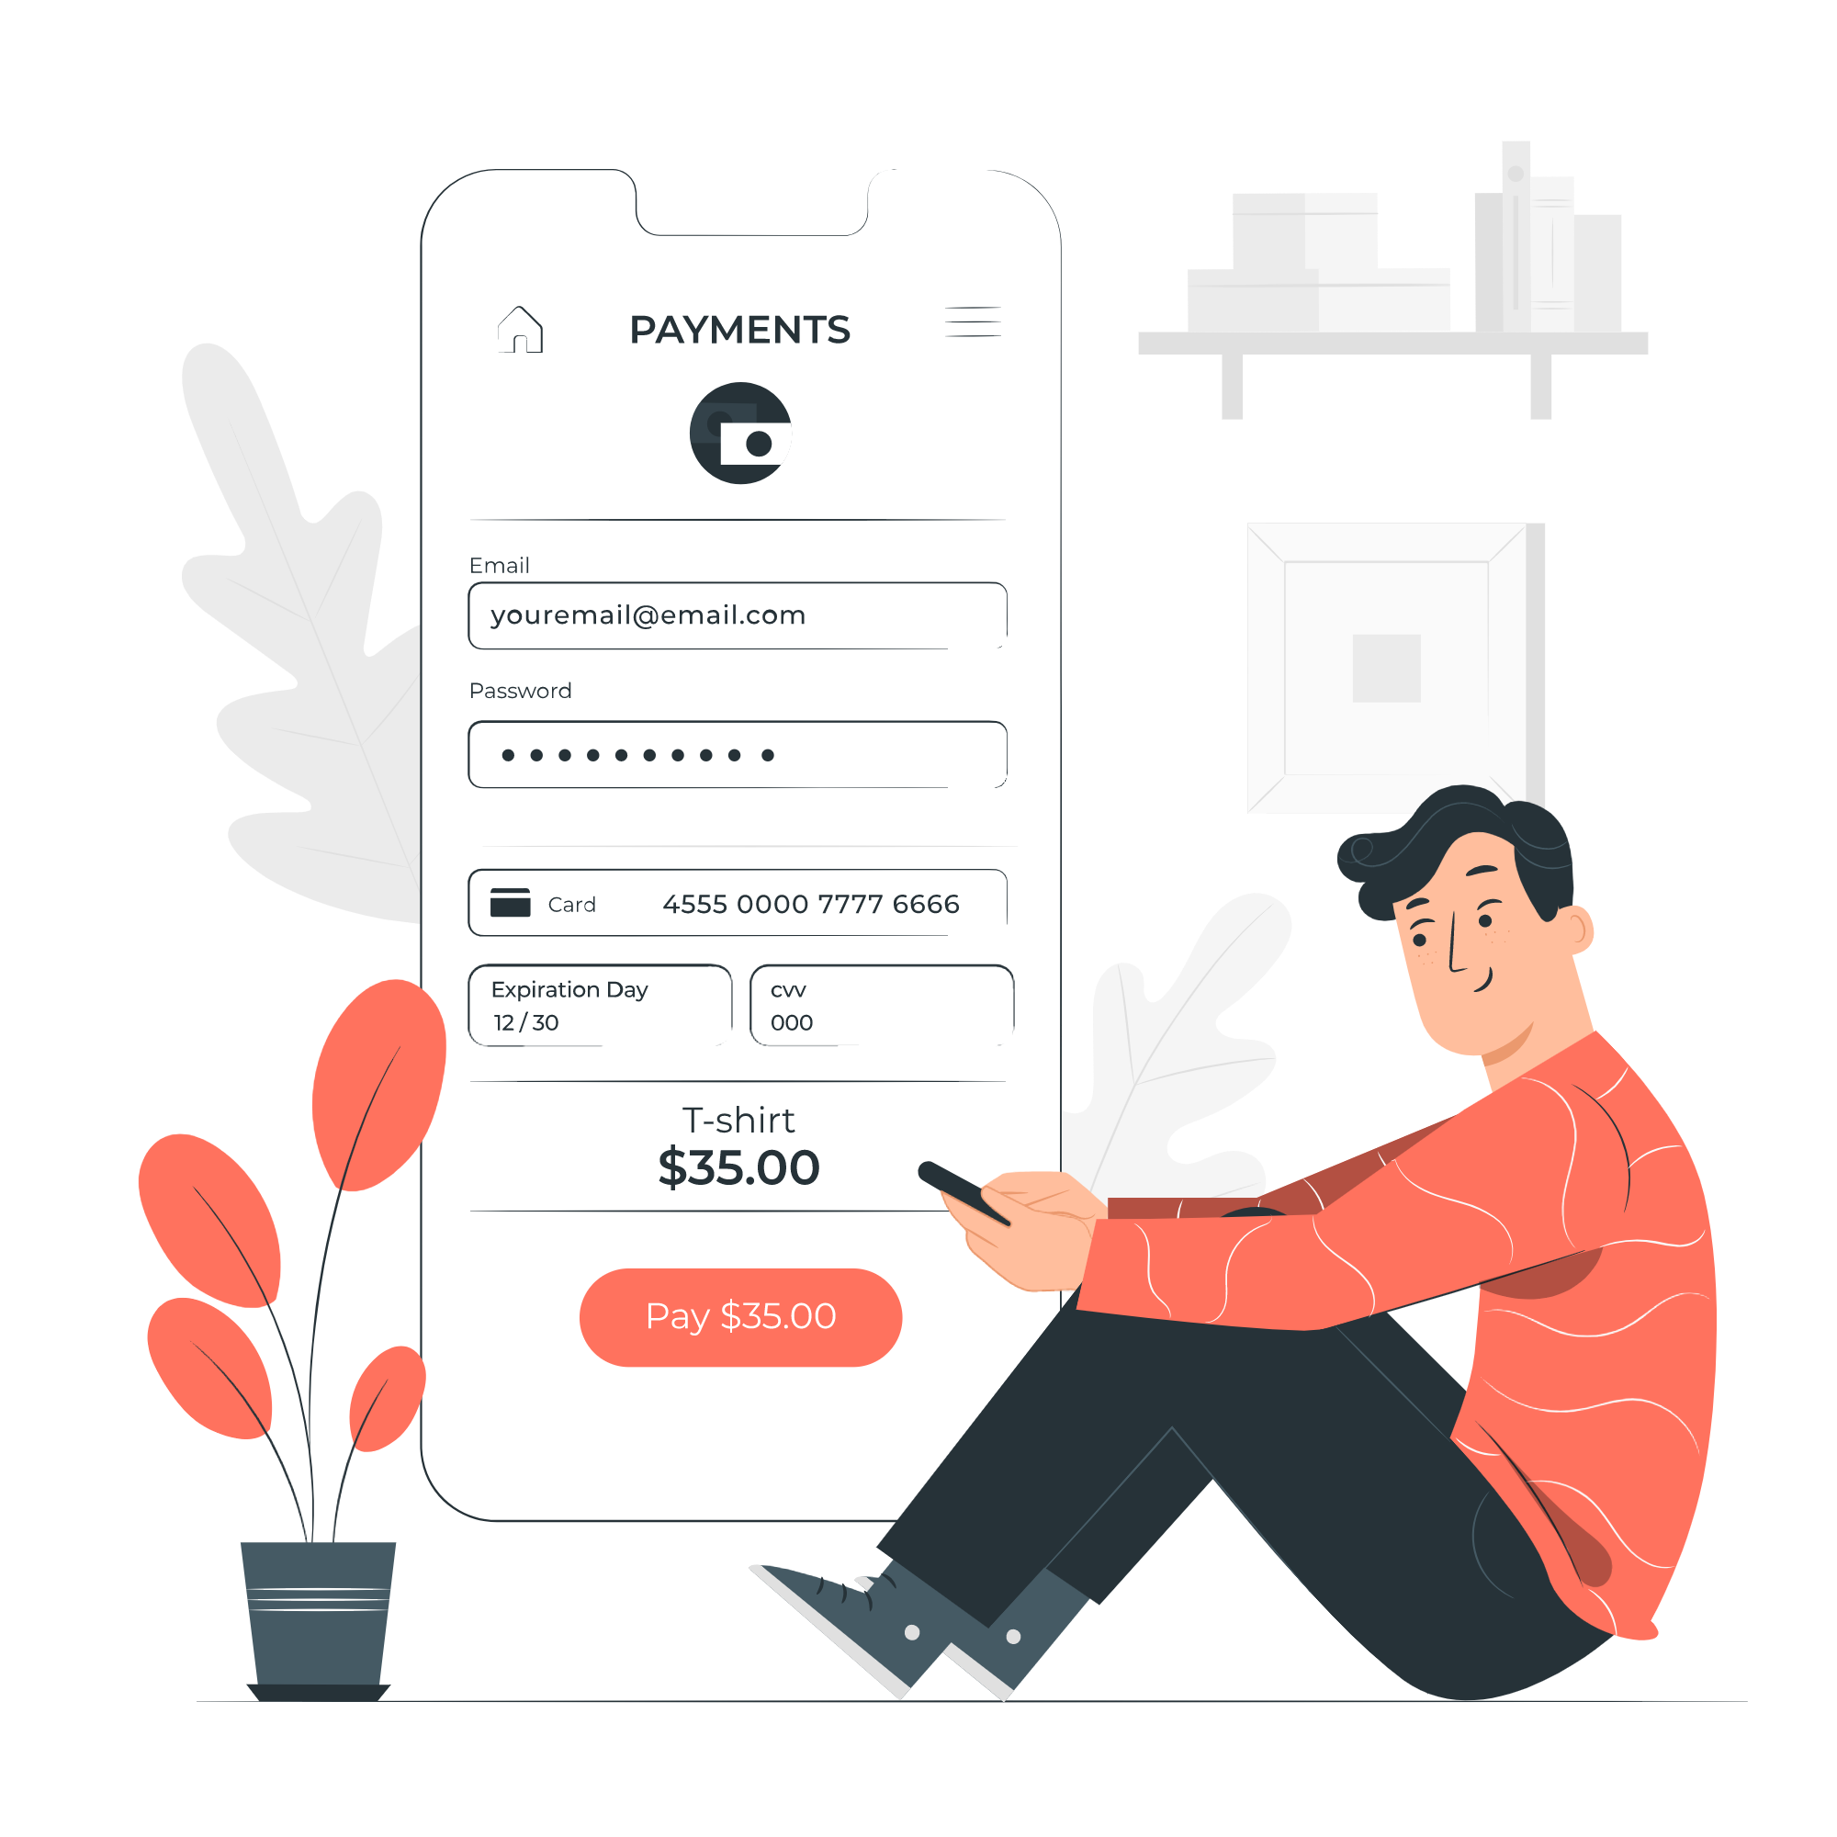
REVENUE MODEL
5-10% of the consultation fee from doctors.
Premium features monthly $2 (approx Rs. 150)
Merchandise at cheap
And affordable rates

Slide 26
REVENUE MODEL ( first year )
Approx. a consultation fee of a professional doctor (800 RS-1200 RS) : 1000 RS
What we ask for (15-25%) : 20% of 1000= 64 RS
One month: 25 Consultations per doctor.
Consider we get 2 professionals to collaborate with us,
5 consultations per month,
5*200= 1000 RS
Our revenue in 1 year from Consultation: 1000*12= 12000 RS

Slide 27
REVENUE MODEL (first year)
Premium Membership
Approx. 10 users will use the premium feature: 12*150*10= 18,000 RS
Merchandise
Approx. merch worth 50 will be sold in one month: 12*50= 600 RS
Play Store
10k downloads in 1 year: 10,000*1.5= 15,00 RS
Merchants and Sellers
Approx 50 RS monthly: 50*12= 600 RS
Total net revenue: 45,200 RS

Slide 28
Total Revenue :
Our Expenses (first year)
Approx. expenses for merch : 40*12=480 RS
Database + app management: 1000*12=12,000 RS
Total Expenses: 12,480 RS
Therefore,
45,200 - 12,480= 32,720 RS
Total revenue :
Total: 32,000RS

Slide 29
SAVINGS MODEL (2nd & 3rd years)
Consultation Fee
15 consultations per month (2 professional doctors) in 2 years= 6000*24=1,44,000
Premium Membership
Approx. 200 users will use the premium feature: 24*150*200= 7,20,000 RS
Merchandise
Approx. merch worth 100 will be sold per month: 24*100= 2400 RS
Play Store
40k downloads in 2 years: 40,000*1.5= 60,000 RS
Merchants and Sellers
Approx 200 RS monthly: 200*24= 4800 RS
Total net revenue: 8,78,400 RS

Slide 30
Total Revenue :
Our Expenses (2nd & 3rd year)
Approx. expenses for merch : 80*24=1920 RS
Database + App management: 2000*24=48,000 RS
Higher position interns 2 (2k/m): 2000*24*2=96,000 RS
10 Interns 20 days per month : 50*10*24*20=2,40,000 RS
Total Expenses: 3,85,920 RS
Savings :
8,78,400 - 3,85,920= 4,92,480 RS
Total: Approx. 5 lakhs

Slide 31
SAVINGS MODEL (4th & 5th year)
Consultation Fee
20 consultations per month (4 professional doctors) in 2 years= 1000*20*24=3,84,000
Premium Membership
Approx. 1500 users will use the premium feature: 24*150*1500= 54,00,000 RS
Merchandise
Approx. merch worth 500 will be sold per month: 24*100= 12000 RS
Play Store
100k downloads in 2 years: 100,000*1.5= 150,000 RS
Merchants and Sellers
Approx 500 RS monthly: 500*24= 12000 RS
Total net revenue: 59,58,000 RS

Slide 32
Total Revenue :
Our Expenses (4th & 5th year)
Approx. expenses for merch : 400*24=9600 RS
Database + app management: 4000*24=96,000 RS
20 Interns for 20 days per month : 50*20*24*20=4,80,000 RS
Higher position interns 2 (2k/m): 2000*24*2=96,000 RS
Employees 3 (20k/m): 20,000*24*3=14,40,000 RS
Total Expenses: 21,21,600 RS
59,58,000 - 21,21,600= 38,36,400 RS
Total: Approx. 38 lakhs

Slide 33
Total profit: 380k+500k+32k
=43,32,000 RS
(in five years)
Upon averaging, for first 5 years
profit per month
~ 72,200RS

Slide 34
EXPENSES & PROFITS (in 5 Years)
₹68,81,600
₹25,20,000
₹43,32,000
OUR REVENUE
OUR EXPENSES
OUR PROFIT
WE ARE ALSO EXPECTING FUNDS AND GRANTS INCLUDING SEED FUNDS.

Slide 35
SWOT ANALYSIS
STRENGTHS
Available on both Play Store and App Store for all users.
Theme based on colour psychology
Real life-like experience with AR model
Seamless integration of various features.
Accessible and user friendly.
Highly secure and safe to use.

Slide 36
WEAKNESSES
Only paid consultations are available
No 100% guarantee on recovery

Slide 37
OPPORTUNITIES
Platform for local merchants working for a social cause.
Creating a widespread mental health awareness.
Developing a healthy and friendly community.
Engagement with pets and animals, chance for appreciating nature.

Slide 38

THREATS
Possible addiction.

Slide 39
LET’S SOLVE SOME PROBLEMS
VS.
PROBLEM
SOLUTION
Increased screen time may affect physical health.
Cookie will alert and send a reminder.

Slide 40
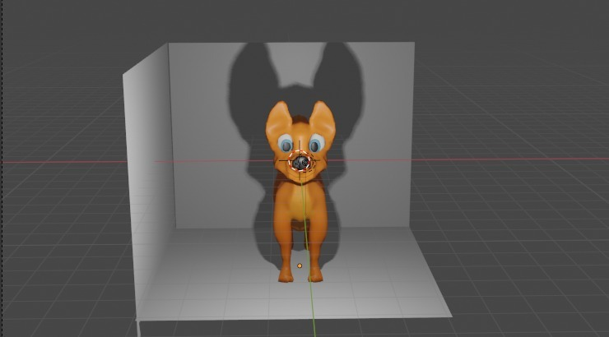
MEET
COOKIE !

Slide 41
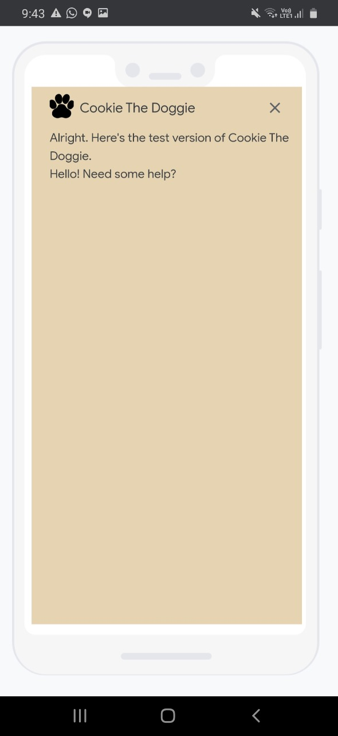
>> DialogFlow Chatbot

Slide 42
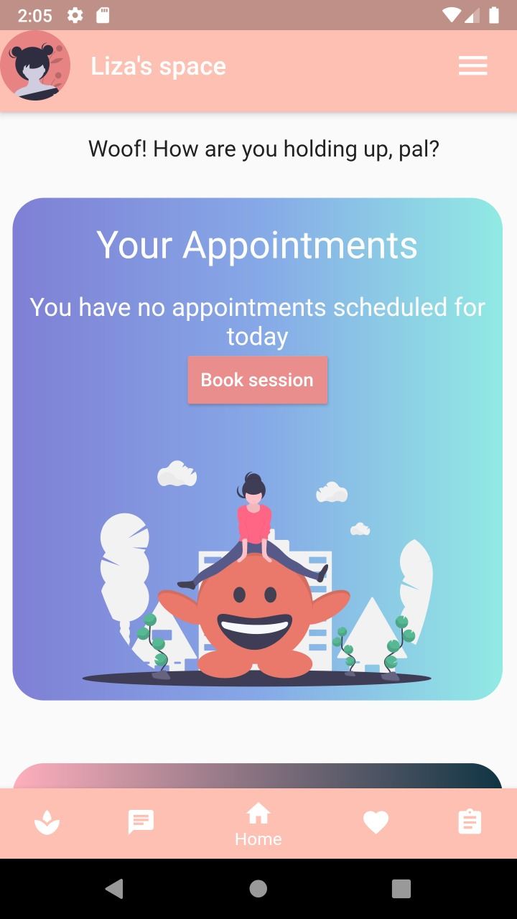
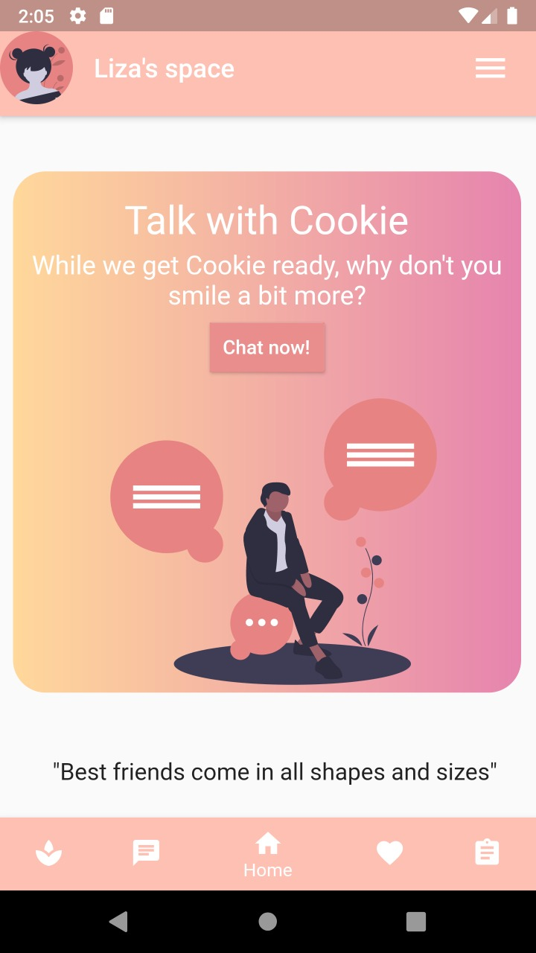
MOBILE
APP

Slide 43
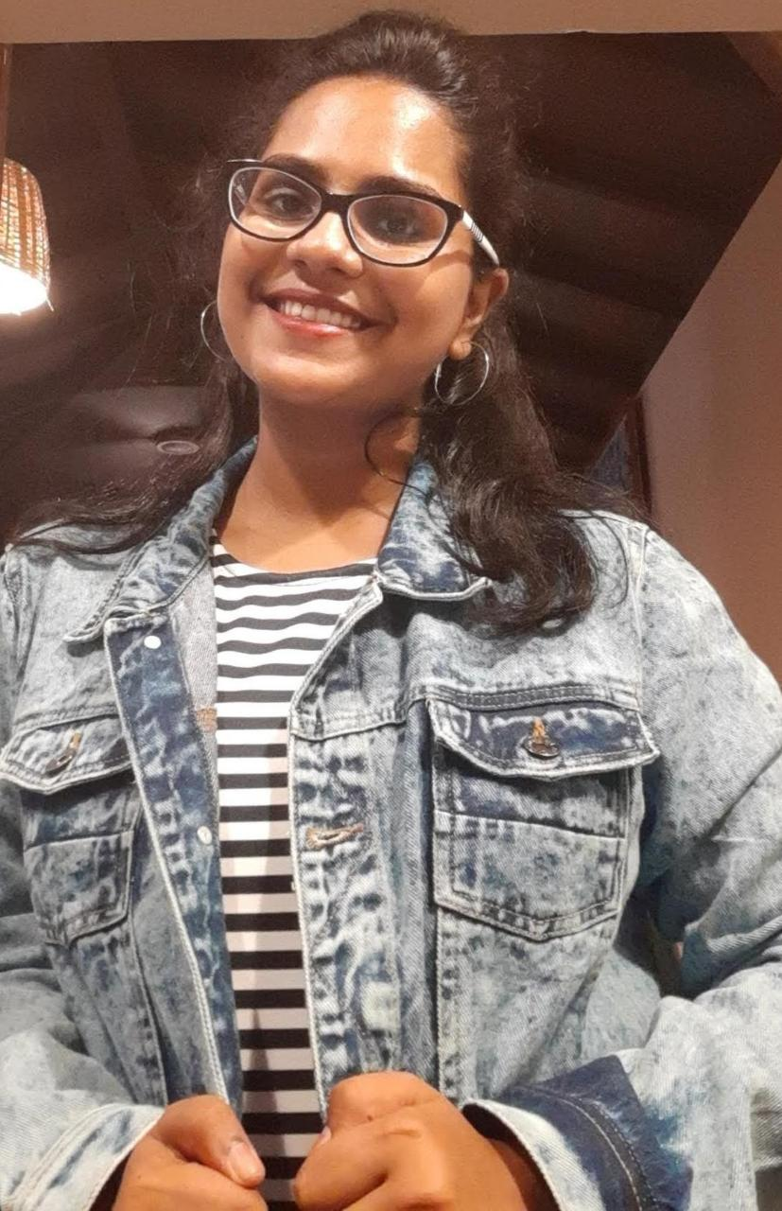
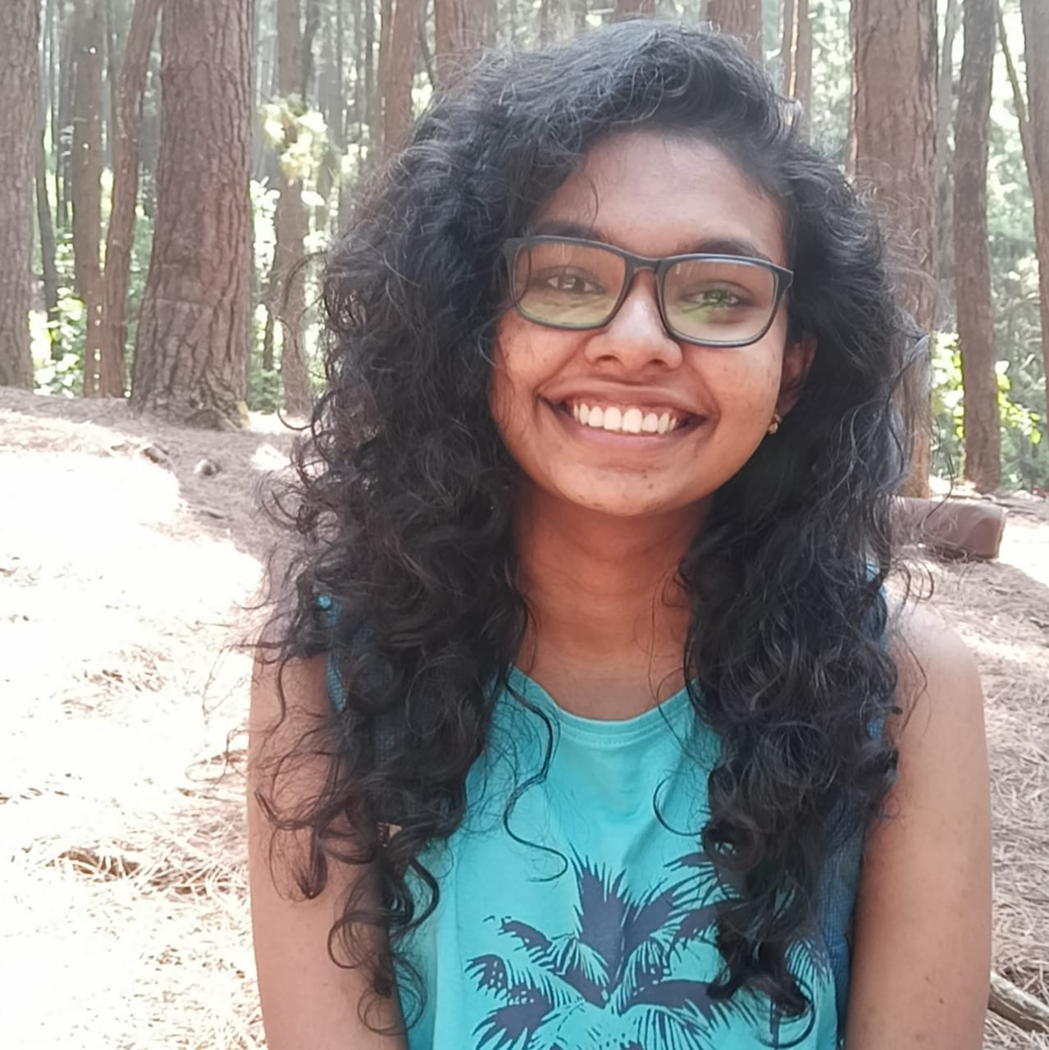
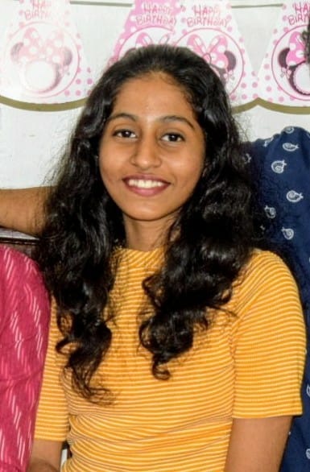
OUR TEAM
Vishnumaya
Nayana
Elizabeth
Co-Founder, ChatBot
Co-Founder, AR Model
Co-Founder, Flutter Dev

Slide 44
THANK YOU

